Slide 1
Software System Modeling

Slide 2

Agenda
UML behavioral diagrams
State machine diagrams
Sequence diagrams

Slide 3
Tools
https://mermaid-js.github.io/ - state machine diagrams, sequence diagram

Slide 4
In a behavior diagram, individual aspects of a system and their changes are displayed at runtime. A behavior diagram is intended to provide clarity, for example, about internal processes, business processes or the interaction of different systems.
The elements in these diagrams resemble the verbs in a natural language and the relationships that connect them typically convey the passage of time. For example, a behavioral diagram of a vehicle reservation system might contain elements such as Make a Reservation, Rent a Car, and Provide Credit Card Details.

Slide 5
The UML defines seven types of behavioral diagram.

Slide 6
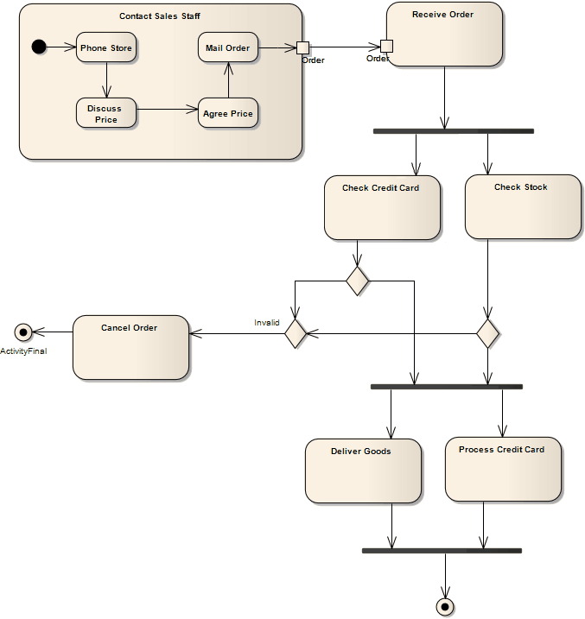
Activity diagram
Activity diagrams model the behaviors of a system, and the way in which these behaviors are related in an overall flow of the system. The activities can be sequential, branched, or concurrent.

Slide 7
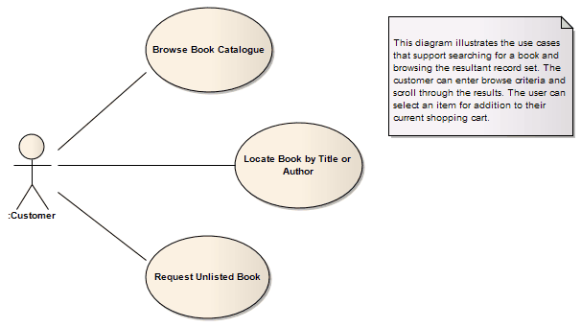
Use case diagram
Model how users, displayed as stick figures called “actors,” interact with the system. This type of UML diagram should be a high-level overview of the relationships between actors and systems, so it can be a great tool for explaining your system to a non-technical audience.

Slide 8
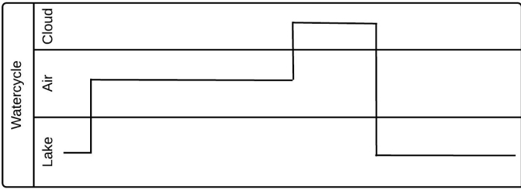
TIMING diagram
Timing diagrams define the behavior of different objects within a time-scale, providing a visual representation of objects changing state and interacting over time. Timing diagrams are powerful tools for making a system as efficient as possible.

Slide 9
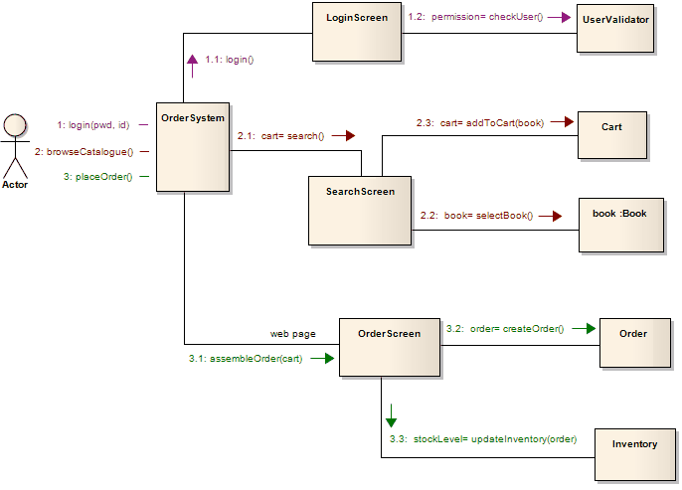
Communication diagram
Communication diagrams offer benefits similar to sequence diagrams, but they will offer a better understanding of how components communicate and interact with each other rather than solely emphasizing the sequence of events. They can be a useful reference for businesses, organizations, and engineers who need to visualize and understand the physical communications within a program.

Slide 10
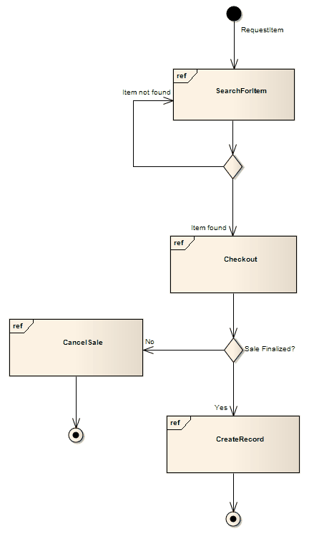
Interaction Overview diagram
An interaction overview diagram is a form of activity diagram in which the nodes represent interaction diagrams. Interaction diagrams can include sequence, communication, interaction overview and timing diagrams.

Slide 11
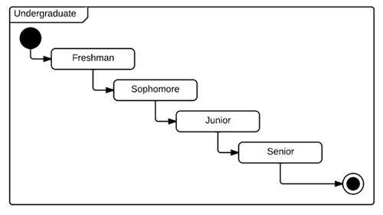
State Diagram
A state machine is any device that stores the status of an object at a given time and can change status or cause other actions based on the input it receives. States refer to the different combinations of information that an object can hold, not how the object behaves. In order to understand the different states of an object, you might want to visualize all the possible states and show how an object gets to each state, and you can do so with a UML state diagram.

Slide 12
State diagram applications
Like most UML diagrams, state diagrams have several uses.
The main applications are as follows:
Depicting event-driven objects in a reactive system.
Illustrating use case scenarios in a business context.
Describing how an object moves through various states within its lifetime.
Showing the overall behavior of a state machine or the behavior of a related set of state machines.

Slide 13

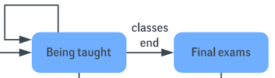


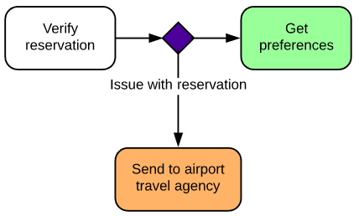

State diagram symbols and components
Choice pseudostate
Event
Exit point
Transition Arrow
First state
Trigger
Terminator

Slide 14
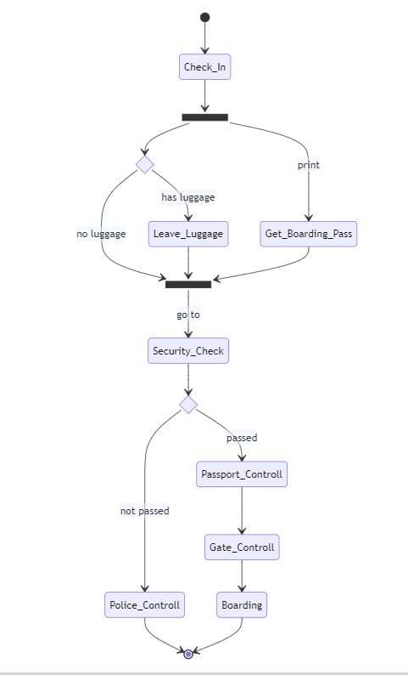

Slide 15
Create a state diagram for an online shopping website

Slide 16
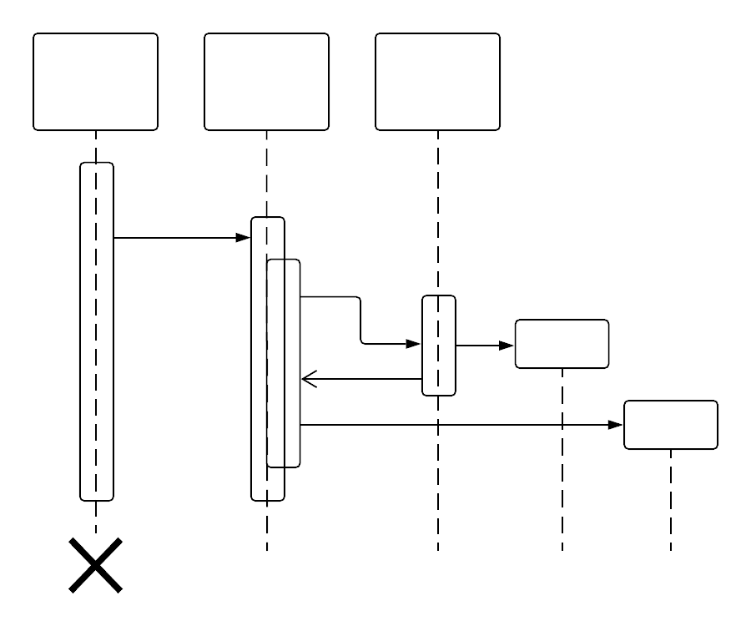
Sequence Diagram
A sequence diagram is a type of interaction diagram because it describes how—and in what order—a group of objects works together. These diagrams are used by software developers and business professionals to understand requirements for a new system or to document an existing process. Sequence diagrams are sometimes known as event diagrams or event scenarios.

Slide 17
Use cases for sequence diagrams
The following scenarios are ideal for using a sequence diagram:
Usage scenario: A usage scenario is a diagram of how your system could potentially be used. It's a great way to make sure that you have worked through the logic of every usage scenario for the system.
Method logic: Just as you might use a UML sequence diagram to explore the logic of a use case, you can use it to explore the logic of any function, procedure, or complex process.
Service logic: If you consider a service to be a high-level method used by different clients, a sequence diagram is an ideal way to map that out.

Slide 18



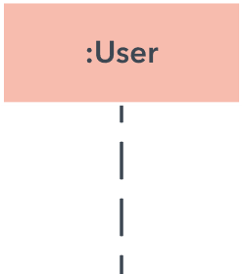
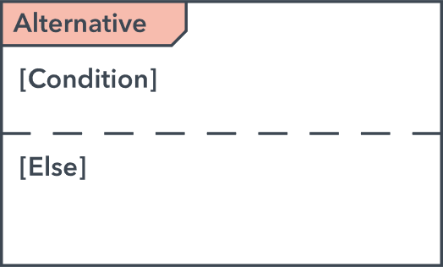
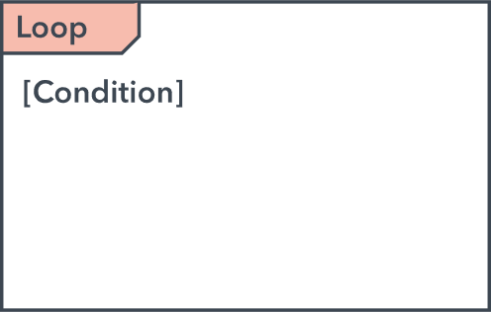
Sequence diagram symbols and components
Object symbol
Actor
Event
Lifeline symbol
Alternative loop symbol
Option loop symbol

Slide 19




Common message symbols
Symbol | Name | Description
 | Synchronous message | This symbol is used when a sender must wait for a response to a message before it continues.
 | Asynchronous message | Asynchronous messages don't require a response before the sender continues. Only the call should be included in the diagram.
 | Asynchronous return message | Represented by a dashed line with a lined arrowhead.
 | Asynchronous create message | Represented by a dashed line with a lined arrowhead. This message creates a new object.
 | Replay message | Represented by a dashed line with a lined arrowhead, these messages are replies to calls.
 | Delete message | Represented by a solid line with a solid arrowhead, followed by an X. This message destroys an object.

Slide 20
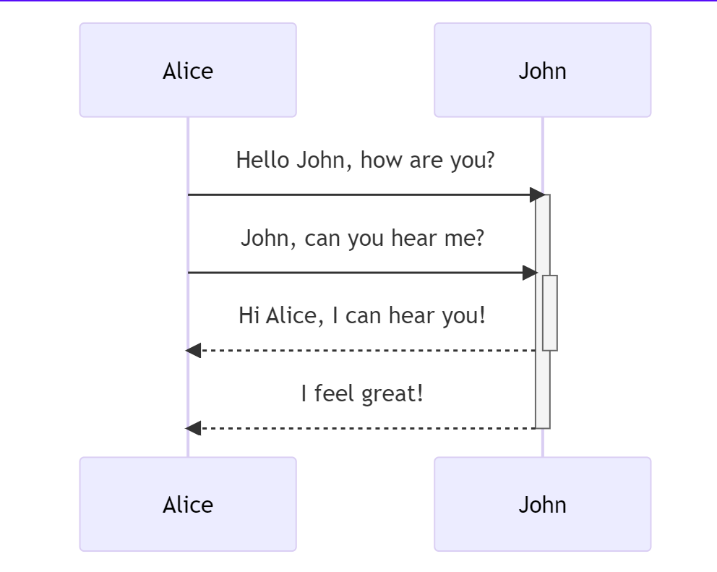

Slide 21
sequenceDiagram
participant ct as Customer
participant catalog as Catalog
participant cart as Cart
participant lg as Login
participant checkout as Checkout
ct->>+catalog: Search Products
catalog-->-ct: Return Products
ct->>+catalog: Select Product
catalog-->-ct: Return Product
ct-)+cart: Add product to cart
cart--)catalog: Decrease available stock
cart--)-ct: Product added
ct->>+cart: Go to cart
cart->>+lg: Check customer logged
alt is not logged in
cart->>lg: Redirect customer to login
lg->>lg: login
else is logged in
lg-->>cart: return customer info
end
cart-->>-ct: return information in cart
ct->>+checkout: Select payment and shipping - order
checkout-->>-ct: Return a order number

Slide 22
